Slide 1
Chapter 19
TELNET
and
Rlogin

Slide 2
CONTENTS
CONCEPT
NETWORK VIRTUAL TERMINAL (NVT)
NVT CHARACTER SET
EMBEDDING
OPTIONS
OPTION NEGOTIATION
SUBOPTION NEGOTIATION
CONTROLLING THE SERVER
OUT-OF-BAND SIGNALING

Slide 3
CONTENTS (Continued)
ESCAPE CHARACTER
MODE OF OPERATION
EXAMPLES
USER INTERFACE
RLOGIN (REMOTE LOGIN)
SECURITY ISSUE

Slide 4

TELNET and Rlogin are
general-purpose
client-server application programs.

Slide 5
19.1
CONCEPT

Slide 6
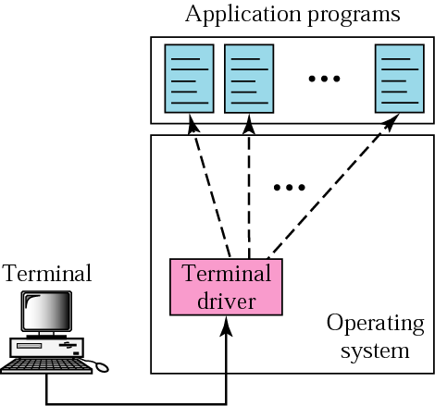
Figure 19-1
Local login

Slide 7
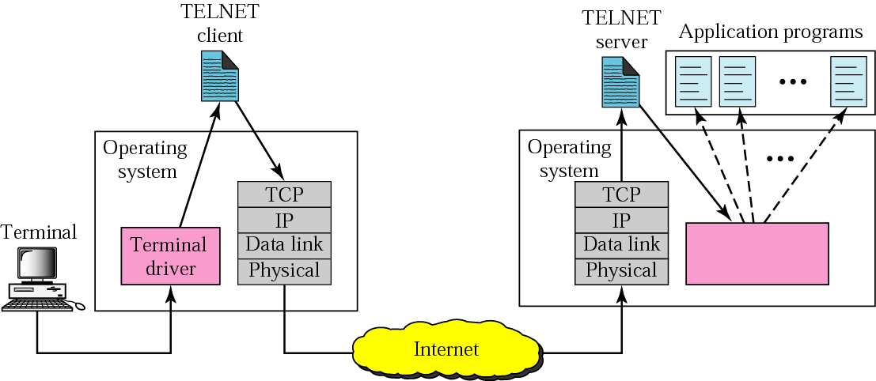
Figure 19-2
Remote login

Slide 8
19.2
NETWORK
VIRTUAL
TERMINAL

Slide 9
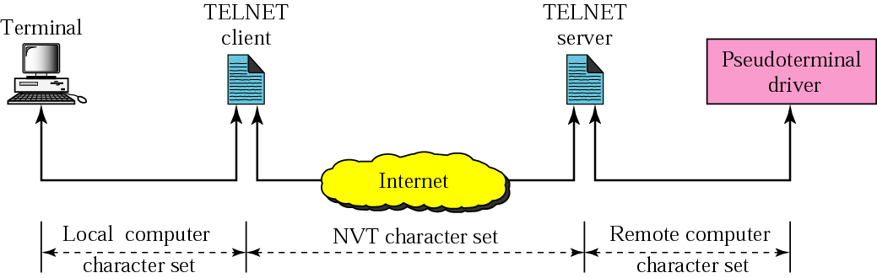
Figure 19-3
NVT

Slide 10
19.3
NVT
CHARACTER
SET

Slide 11
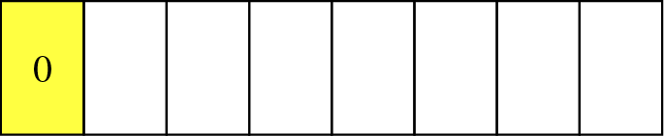
Figure 19-4
Format of data characters

Slide 12
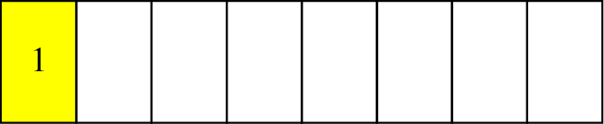
Figure 19-5
Format of control characters

Slide 13
19.4
EMBEDDING

Slide 14
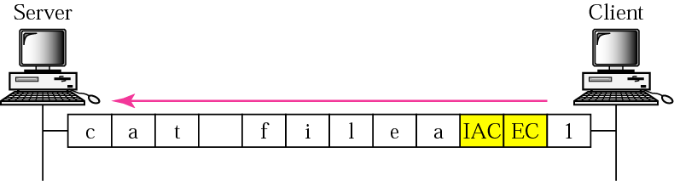
Figure 19-6
Embedding

Slide 15
19.5
OPTIONS

Slide 16
19.6
OPTION
NEGOTIATION

Slide 17
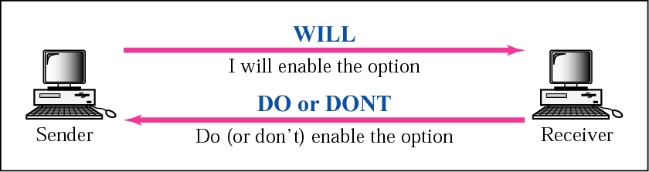
Figure 19-7
Offer to enable

Slide 18
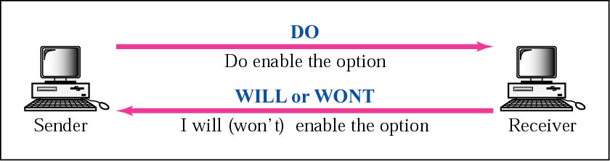
Figure 19-8
Request to enable

Slide 19
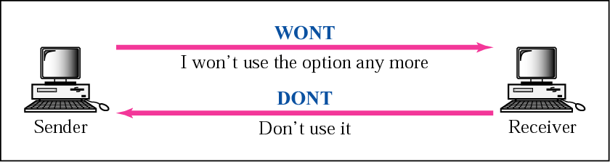
Figure 19-9
Offer to disable

Slide 20
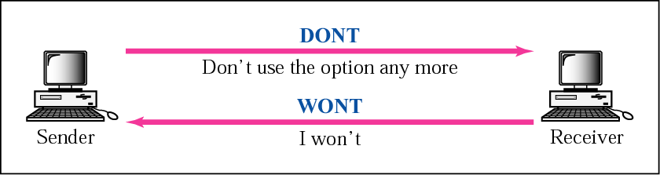
Figure 19-10
Request to disable

Slide 21
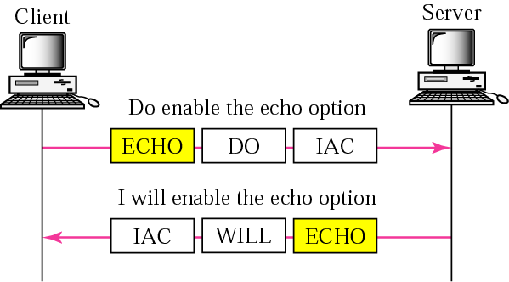
Figure 19-11
Echo option example

Slide 22
19.7
SUBOPTION
NEGOTIATION

Slide 23
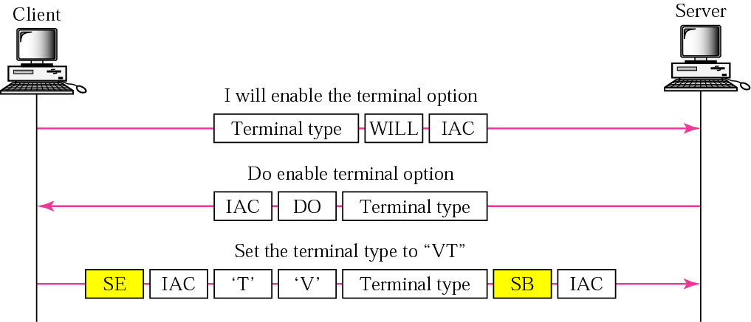
Figure 19-12
Example of suboption negotiation

Slide 24
19.8
CONTROLLING
THE
SERVER

Slide 25
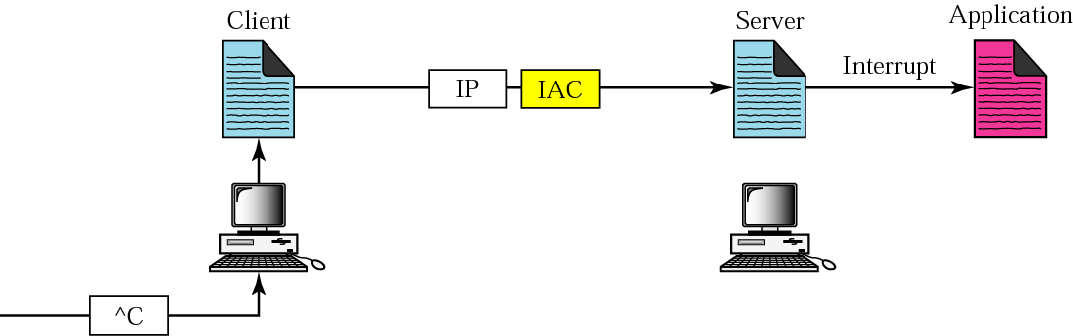
Figure 19-13
Example of interrupting an
application program

Slide 26
19.9
OUT-OF-BAND
SIGNALING

Slide 27
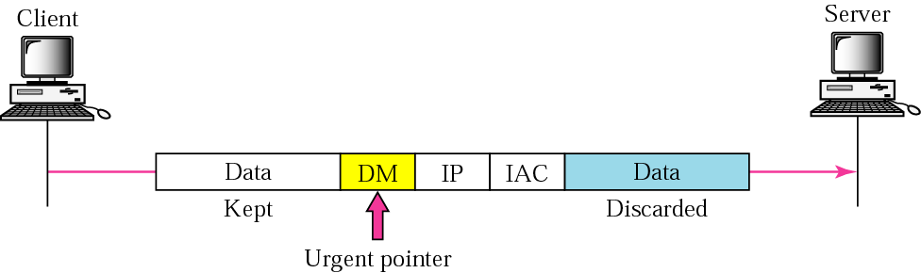
Figure 19-14
Out-of-band signaling

Slide 28
19.10
ESCAPE
CHARACTER

Slide 29
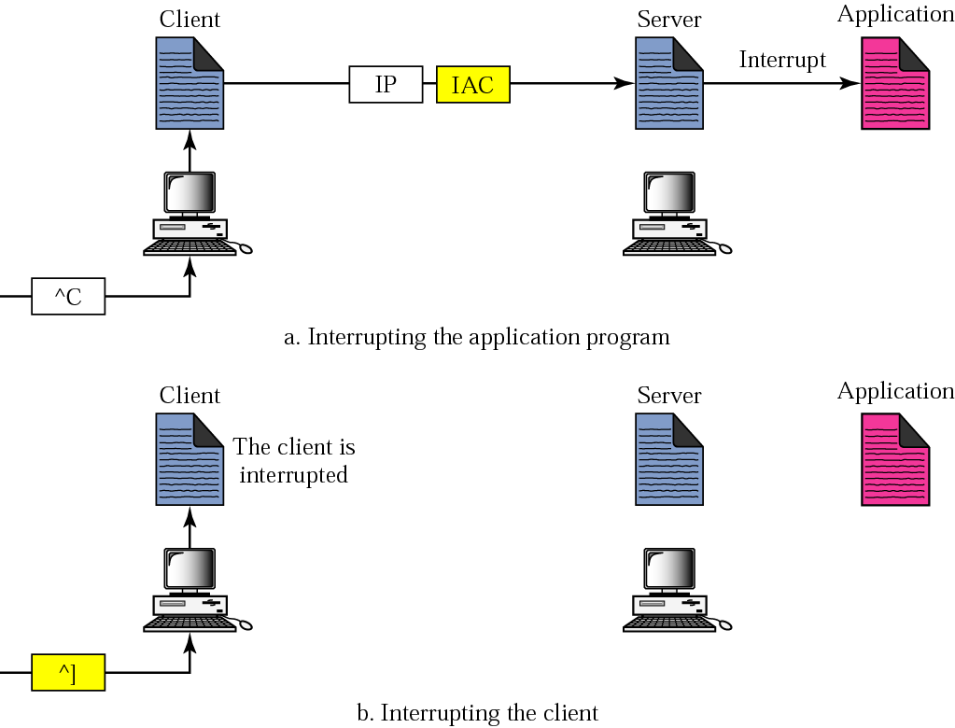
Figure 19-15
Two different interruptions

Slide 30
19.11
MODE
OF
OPERATION

Slide 31
19.12
EXAMPLES

Slide 32
Example 1
In this example, we use the default mode
to show the concept and its deficiencies
even though it is almost obsolete today.
The client and the server negotiate
the terminal type and terminal speed and
then the server checks the login
and password of the user. See Figure 19.16.

Slide 33
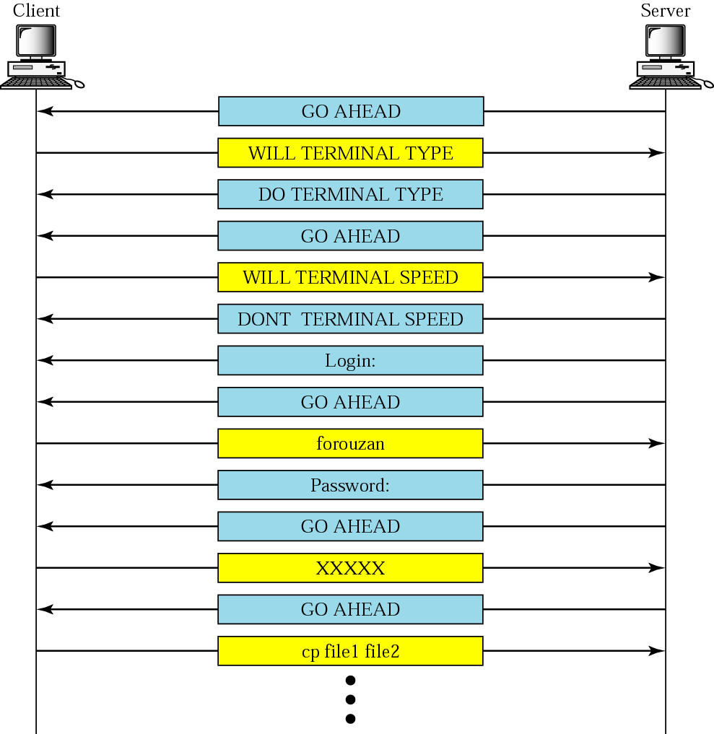
Figure 19-16
Example1

Slide 34
Example 2
In this example, we show how the client switches to the character mode. This requires that the client request the server to enable the SUPPRESS GO AHEAD and ECHO options. See Figure 19.17.

Slide 35
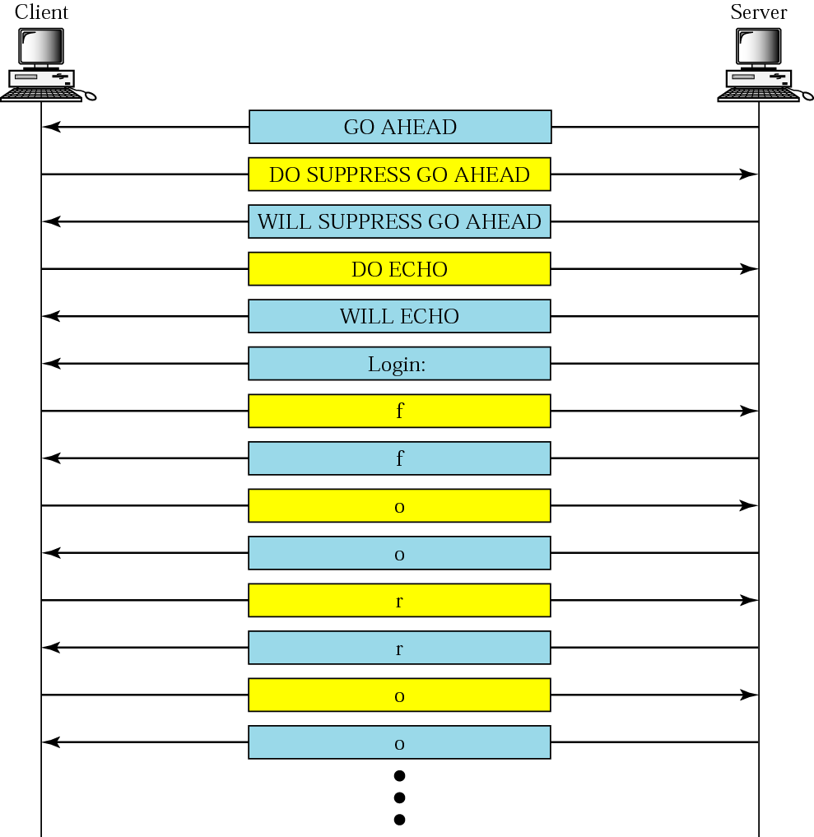
Figure 19-17
Example 2

Slide 36
19.13
USER
INTERFACE

Slide 37
19.14
RLOGIN
(REMOTE LOGIN)

Slide 38
The Rlogin process
uses the TCP port 513.

Slide 39
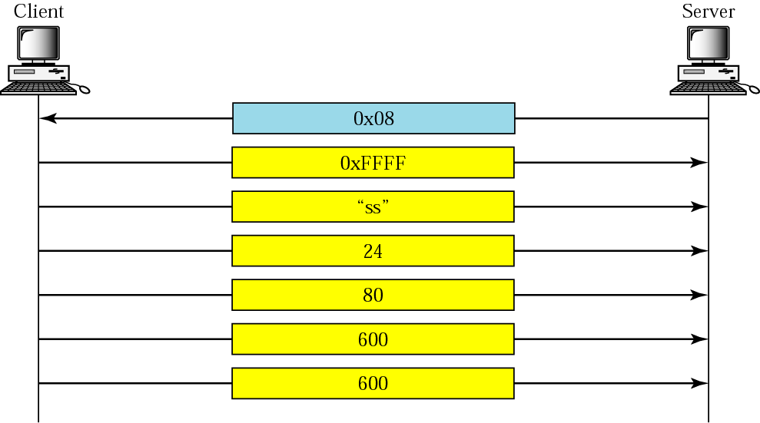
Figure 19-18
Connection establishment

Slide 40
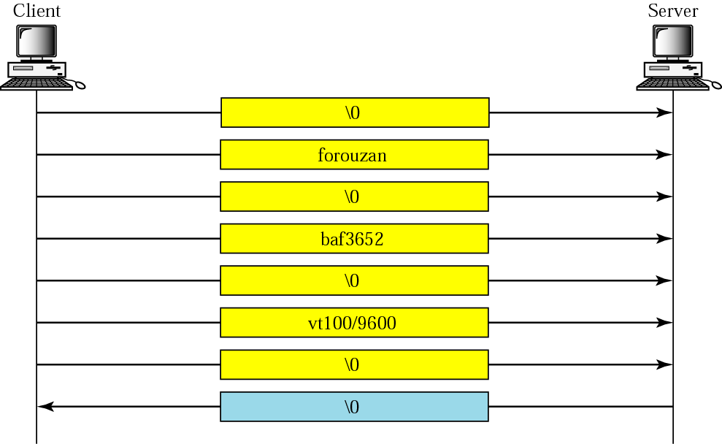
Figure 19-19
Sending ss command from the
client to the server

Slide 41
19.15
SECURITY
ISSUE

